Slide 1
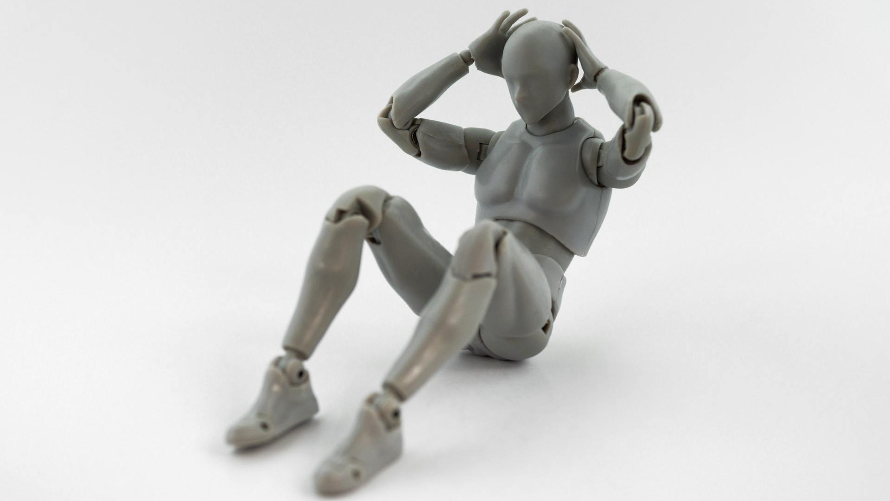
Introduction to the Robot Operating System (ROS)

Slide 2
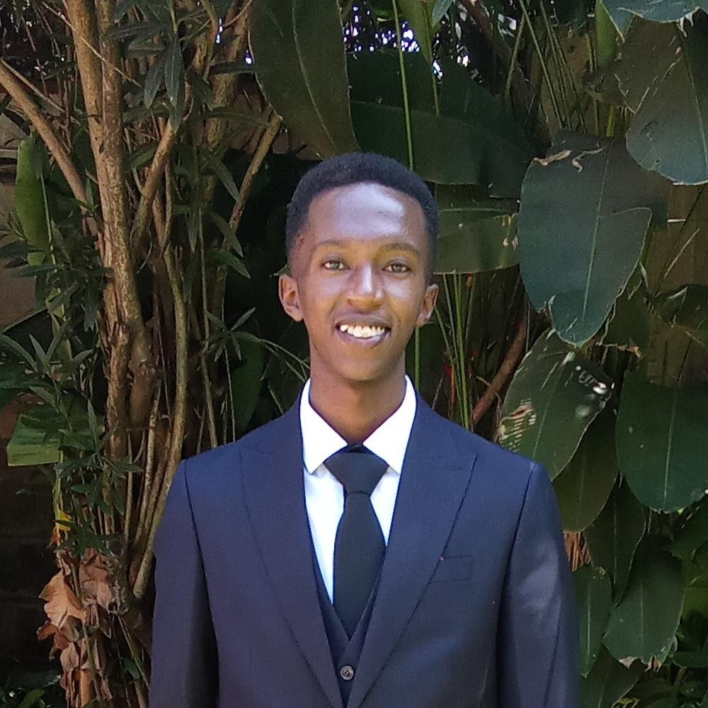
Lenny Ng’ang’a
Robotics Dojo 2022 & 2023
Robotics Dojo Trainer 2023
Robotics Dojo Research 2024

Slide 3

Robot Operating System
The Robotics SDK
Not an Operating System
Middle-ware

Slide 4
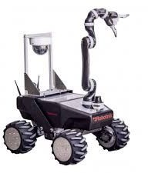
Why ROS?
Distributed Computing

Slide 5
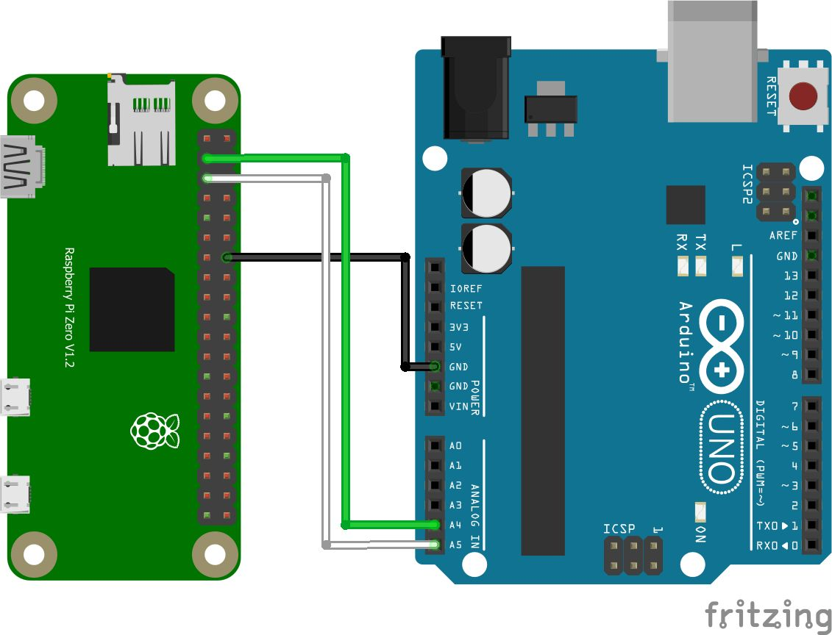
Why ROS?
Distributed Computing

Slide 6
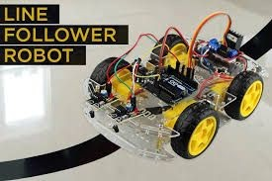
Why ROS?
Do not reinvent the wheel

Slide 7
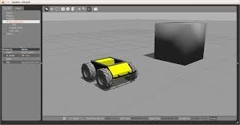
Why ROS?
Rapid Testing

Slide 8
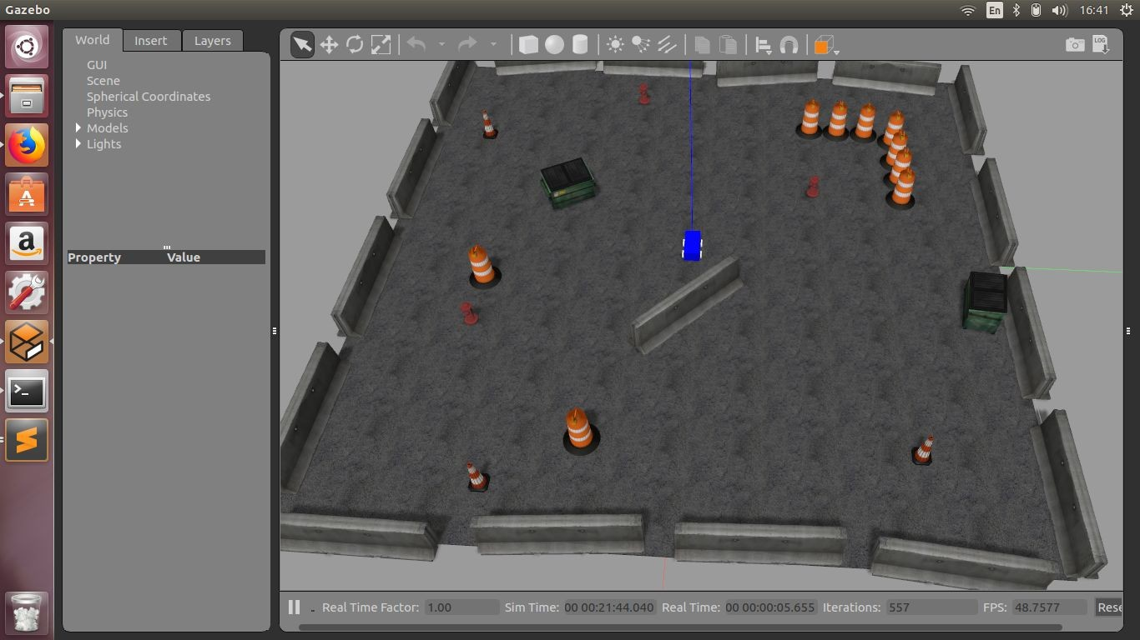
Why ROS?

Slide 9
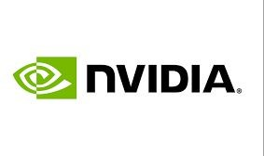

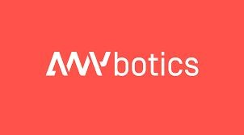

Why ROS?
Industry Ready

Slide 10
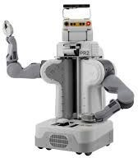
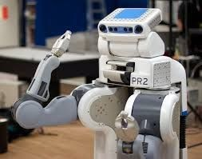
Robotics Research

Slide 11
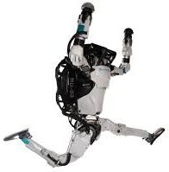
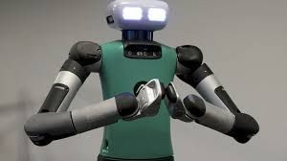
Robotics Research

Slide 12
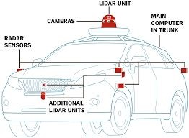

Robotics Research

Slide 13
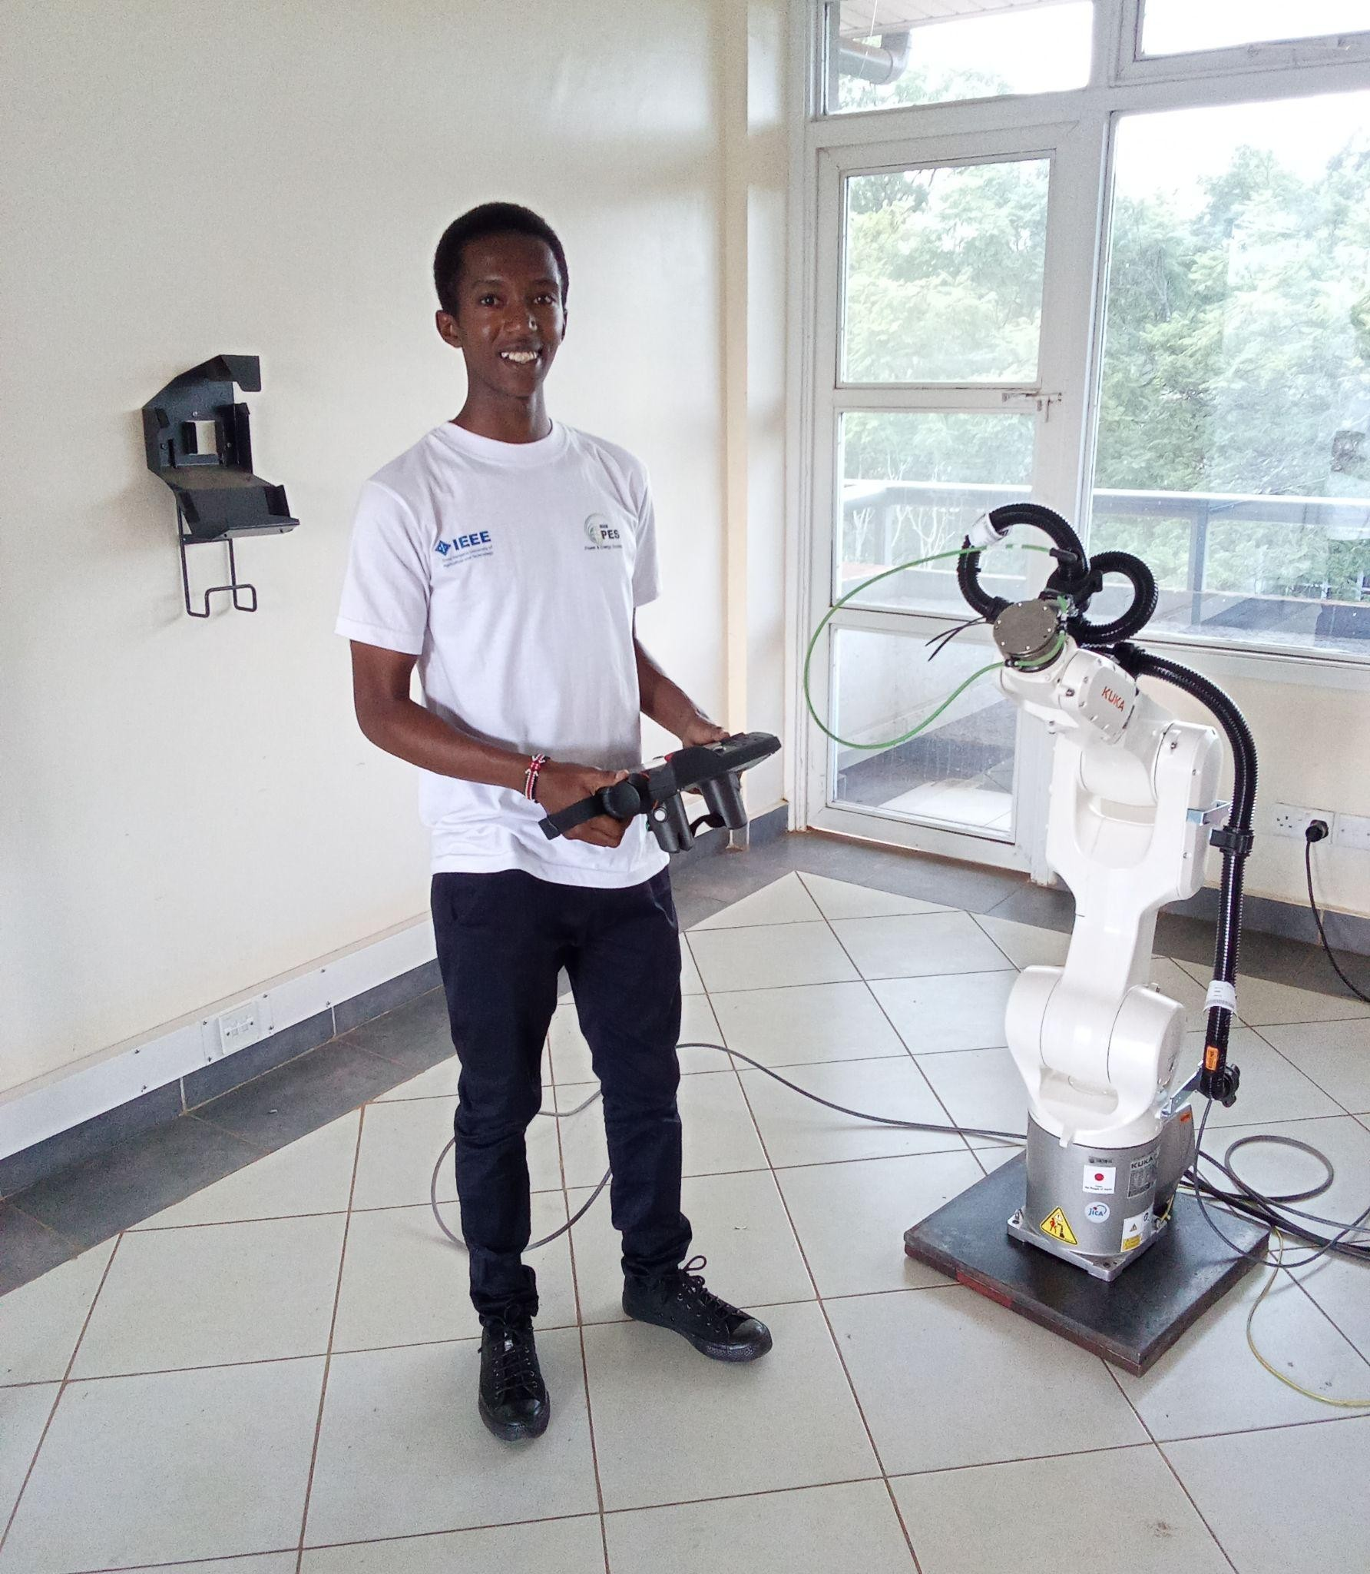
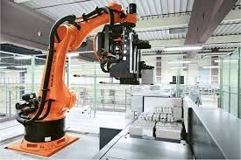
Robotics Research

Slide 14


ROS BASIC CONCEPTS

Slide 15
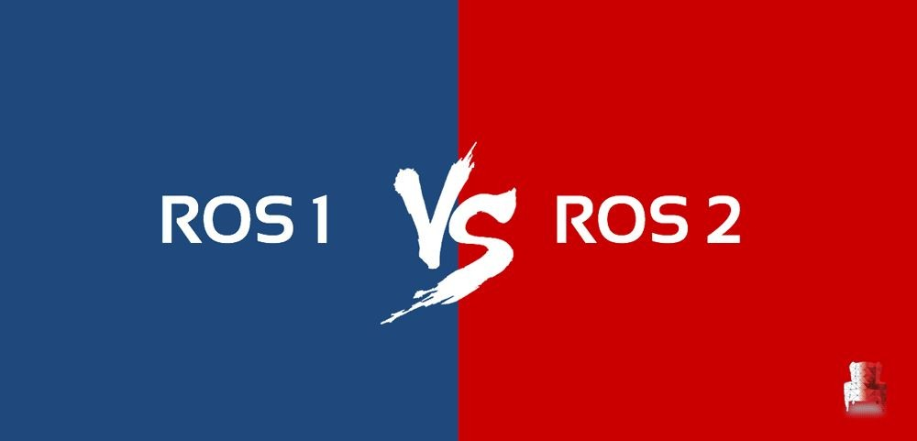
ROS1 vs ROS2
Windows Support in ROS2!
No ROS Master
Faster
Architecture

Slide 16
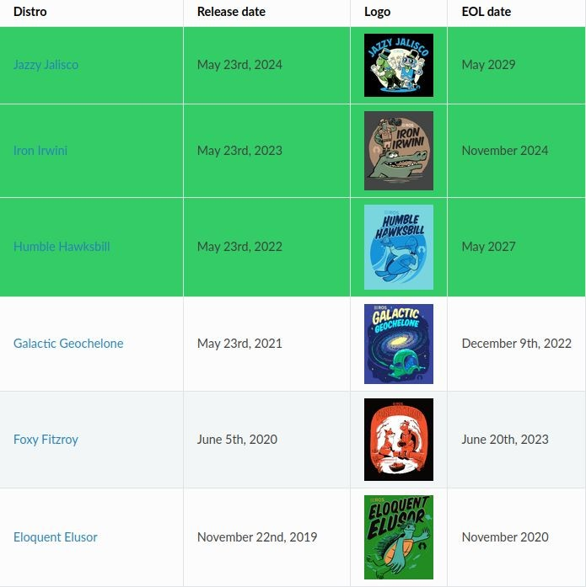
ROS2 Distributions
We’ll use ROS2 Humble Hawksbill

Slide 17
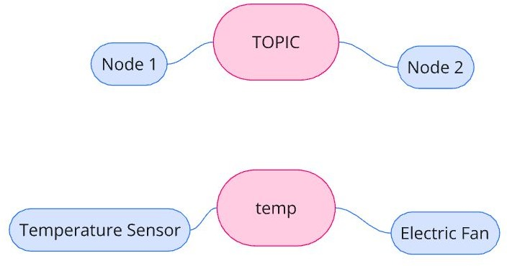
ROS Nodes & Topics
Nodes can send / receive data
Via Topics
Send = Publish to Topic
Receive = Subscribe to Topic

Slide 18
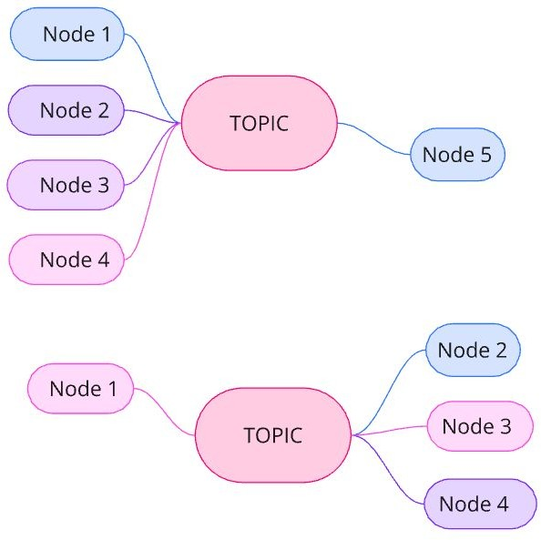
ROS Nodes & Topics
Flexible Structure!
Robots typically have many Nodes & Topics

Slide 19
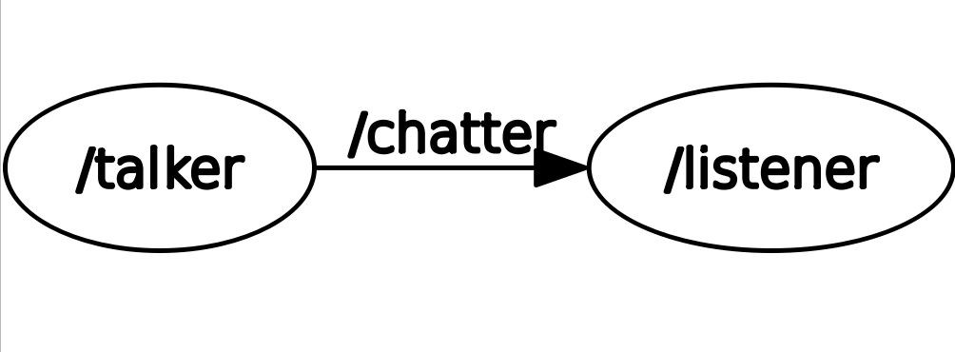
ROS Nodes & Topics
Nodes
talker
listener
Topic
chatter

Slide 20
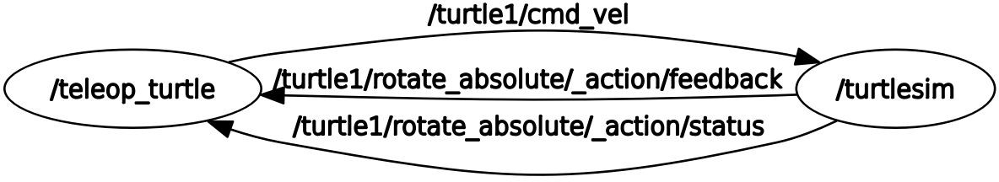
ROS Nodes & Topics
Nodes
teleop_turtle
turtle_sim
Topics
turtle1/cmd_vel
…/feedback
…/status

Slide 21

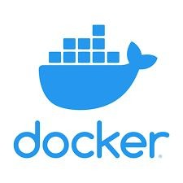
Setting Up ROS (Docker)
Prerequisites:
Docker
Setup:
Follow instructions here

Slide 22
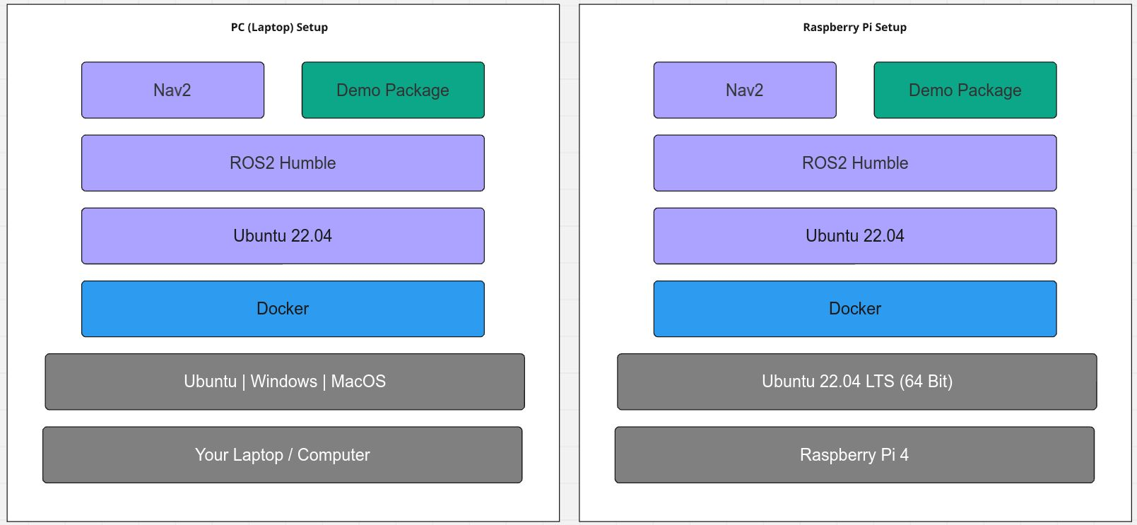
rdj-2024

Slide 23

Resources
What is ROS?
History of ROS
Companies using ROS
ROS1 vs ROS2
Changes between ROS1 and ROS2
ROS2 Releases
How to Learn ROS2
Getting Started with ROS2
ROS2 Humble Documentation

Slide 24

ROBOTICS DOJO 2024
Thanks for your Attention
Lenny Ng’ang’a
Robotics Researcher
codewithlennylen254@gmail.com

